Slide 1
DataCo
Supply Chain
Analytics Report
Identifying late delivery drivers · Optimising product profitability
Enhancing fulfilment efficiency · Strategic recommendations
Comprehensive analysis across supply chain, sales & customer data

Slide 2
Problem Statement
“
How can we leverage comprehensive supply chain, sales, and customer data to develop an analytics system that accurately identifies and predicts key factors contributing to late deliveries, optimises product and customer profitability, enhances fulfilment efficiency, and provides actionable insights and strategic recommendations to improve overall business performance and customer satisfaction?
📦 Late Delivery Prediction
💰 Product & Profitability
⚡ Fulfilment Efficiency
📊 Actionable Insights

Slide 3
Objectives
Five analytical goals driving this supply chain study
1
Analyse Late Delivery Factors
Across shipping mode, region, market.
2
Identify Top Products
Identify which products drive the most sales, profit, and order volume.
3
Deep Dive Analysis
Uncover broader market trends and category-specific strategies.
4
Order Status distribution & Financial Impacts
Top 3 High-Risk Categories & financial impacts and mitigation strategies.
5
Build Predictive Model
Estimate whether an order is likely to face late delivery risk.

Slide 4
Executive Summary
Five focus areas revealed by analysis of supply chain, sales, and customer data
54.8%
95%
39,832
~2%
Average late delivery rate
First Class late rate
Pending payment orders
Sales lost to fraud
Late Deliveries
First Class promises 1-day delivery but consistently takes 2 days, driving a 95% late rate. Standard Class sits at 38%.
Geographic Risk
USCA and Africa markets lead in late rates. Several countries (Armenia, Gambia, Eritrea) show 100% late delivery rates
Payment Issues
All PENDING_PAYMENT orders link exclusively to Payment_Type_ID 4 — a systemic gateway issue, not customer behaviour.
Financial Risk
Top 3 categories lose ~2% of sales to fraud and cancellations. Fraud loss consistently exceeds cancellation rate across all three.

Slide 5
📦
Late Delivery Analysis

Slide 6
Key Findings & High-Risk Country Root Causes
📋 Top Contributors to Late Deliveries
🌍 Why High-Risk Countries Struggle
01
Specific Countries
Armenia, Gambia, and Eritrea show 100% late rates — logistics and infrastructure gaps.
02
Product Categories
Girls’ Fashion, Camping & Hiking, Water Sports and Books show 100% late rates.
🚢
Logistics Challenges
Inadequate port and road infrastructure extends in-transit times beyond carrier estimates.
🛃
Customs & Border
Slow customs clearance and stringent import documentation create unpredictable delays.
03
First Class Scheduling
Scheduled at 1 day but takes 2 days consistently — SLA is fundamentally unattainable.
04
Africa Market
Highest late delivery rate among all markets — limited shipping infrastructure and regional gaps.
⚡
Operational Capacity
Carrier capacity constraints and lack of local fulfilment centres increase lead times significantly.
⚖️
Economic / Political
Sanctions, currency instability, or regulatory barriers can halt or slow cross-border shipments.

Slide 7
Shipping Mode Deep Dive: First Class vs Standard Class
First Class
Standard Class
Late Rate:
95.27%
Late Rate:
38.13%
Scheduled:
1 day
Scheduled:
4 days
Actual:
2 days
Actual:
4 days
Avg Delay:
+1 day
Avg Delay:
~0 days
Root Cause & Recommended Actions
Unrealistic SLA: First Class schedules 1-day delivery but logistics cannot support it — creating near-universal failure. Revise SLAs: Update First Class to 2-day promise to align with actual capability, improving customer satisfaction. Standard Class: 38% late rate still significant — investigate last-mile routing, carrier performance, and order complexity for this cohort.

Slide 8

Product & Market Trending Analysis

Slide 9
Top 10 Products by Total Sales
Products contributing the most to sales, profit, and order volume across the unified dataset
#
Product Name
Total Sales
Total Profit
Orders
Avg Unit Value
1
Field & Stream Sportsman 16 Gun Fire Safe
$6,929,653.69
$756,220.77
15,164
$399.98
2
Perfect Fitness Perfect Rip Deck
$4,421,143.14
$493,828.30
20,359
$59.99
3
Diamondback Women’s Serene Classic Comfort Bi…
$4,118,425.57
$427,455.57
12,299
$299.98
4
Nike Men’s Free 5.0+ Running Shoe
$3,667,633.20
$379,915.82
11,092
$99.99
5
Nike Men’s Dri-FIT Victory Golf Polo
$3,147,800.00
$350,421.03
17,869
$50.00
6
Pelican Sunstream 100 Kayak
$3,099,845.09
$324,076.37
13,727
$199.99
7
Nike Men’s CJ Elite 2 TD Football Cleat
$2,891,757.66
$311,902.82
18,783
$129.99
8
O’Brien Men’s Neoprene Life Vest
$2,888,993.91
$318,451.43
16,623
$49.98
9
Under Armour Girls’ Toddler Spine Surge Runni…
$1,269,082.67
$126,278.51
9,825
$39.99
10
Dell Laptop
$663,000.00
$69,656.81
442
$1,500.00

Slide 10
Key Insights — Top 10 Products
Strategic patterns derived from sales, profit, and order volume analysis
1
2
3
Dominant High-Value Items
Field & Stream Gun Safe ($6.93M) and Perfect Rip Deck ($4.42M) lead — high-ticket items are critical revenue drivers.
Consistent Profitability
High sales consistently correlate with high profit — indicating effective pricing and cost management across popular items.
Sales vs. Order Volume
Gun Safe wins on unit value (15K orders), Rip Deck wins on volume (20K orders) — two distinct revenue models.
4
5
Strategic Importance of Core Products
Nike footwear, Pelican kayaks, and O’Brien life vests are consistently strong performers — reliable revenue anchors that require continued inventory and marketing support.
Potential for Category Deep Dive
The diversity of top products points to an opportunity for deeper category-level analysis to uncover broader market trends and category-specific growth strategies.

Slide 11
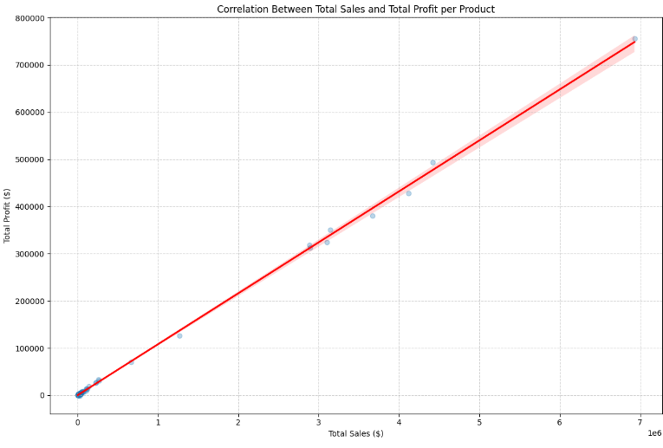
Correlation between Total Sales and Total Profit
The scatter plot above visually confirms a strong positive correlation between Total Sales and Total Profit. The upward-sloping regression line indicates that as Total Sales increase, Total Profit also tends to increase. This supports the observation that for most products, effective pricing and cost management are in place, leading to higher profitability as sales volume grows.

Slide 12
Two Revenue Models - Findings and Strategic Recommendations
Derived from Top 10 Products analysis - Slide 9 data
MODEL A | High Unit Value
Field and Stream Gun Safe | $399.98/unit | 15,164 orders | $6.93M
MODEL B | High Order Volume
Perfect Fitness Rip Deck | $59.99/unit | 20,359 orders | $4.42M
Key Findings
- Revenue through premium pricing, not scale.
$399.98/unit is 6.7x higher than Rip Deck. $6.93M from just 15K orders - fewer fulfilment transactions needed.
- Stronger per-transaction profit impact.
$756K profit at 10.9% margin. Premium buyers show low price sensitivity - protecting margins.
- Seasonal, concentrated demand window.
August peak from hunting season. Predictable demand spikes make inventory planning critical and achievable.
Key Findings
- Revenue through market reach, not price premium.
$4.42M from 20,359 orders at $59.99. 34% more orders than Gun Safe despite a 6.7x lower unit price.
- Thin margins make fulfilment efficiency critical.
$493K profit at 11.2% margin. Shipping delays and returns erode thin per-unit margins quickly at volume.
- Broad, repeat-purchase product with high elasticity.
Fitness accessories at $60 attract impulse and repeat buyers. Easily scalable across demographics.
Strategic Recommendations
-> Pre-stage inventory before Aug-Sep peak to prevent stockouts during concentrated demand windows.
-> Invest in premium fulfilment - expedited shipping and secure packaging - to justify the high price point.
-> Cross-sell accessories to grow basket size. High-value transactions maximise attach rate returns.
Strategic Recommendations
-> Optimise fulfilment efficiency. Standard Class and bulk dispatch reduce per-unit shipping cost to protect margins.
-> Bundle promotions and subscription offers to boost repeat purchase rate and customer lifetime value.
-> Scale via targeted digital marketing. Fitness influencer channels drive volume at low acquisition cost.
Strategic Priority: Protect Model A margins through premium service and inventory timing; scale Model B through operational efficiency and repeat purchases. Manage both models distinctly.

Slide 13
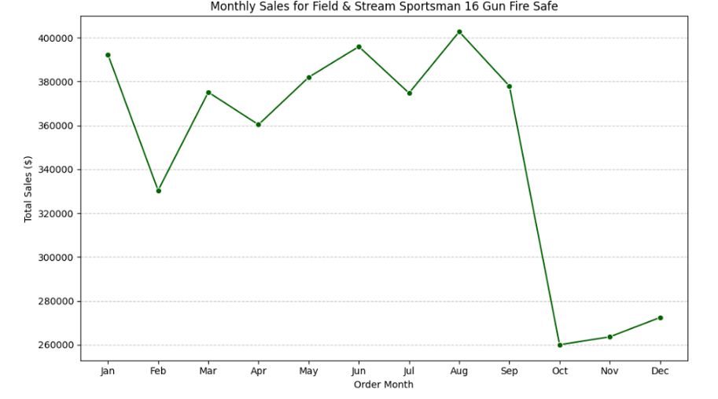
Seasonal Analysis — Field & Stream Sportsman 16 Gun Fire Safe
Monthly total sales ($) — seasonal demand patterns for inventory and marketing planning
📈 Peak: Aug ~$420K
Hunting season & back-to-school overlap drive the highest monthly sales.
📉 Trough: Oct ~$260K
Sharp post-summer drop signals need for targeted promotions in Q4.
📋 Inventory Implication
Pre-position stock in Jun–Aug; scale back in Oct–Dec to avoid overstock.

Slide 14
📋
Order Status distribution & Financial Impact

Slide 15
Order Status Distribution
Analysis of 180,519 orders reveals fulfilment health and risk areas
59,491
Complete
Orders ✓
39,832
Pending
Payment ⚠️
13,558
High Risk
(Fraud + Hold)

Slide 16
Financial Impact — Top 3 High-Risk Categories
Sales exposure by order status — how each dollar of revenue is at risk
Healthy Sales
Pending Payment
Suspected Fraud
Cancelled
Cleats
$3.27M (73.8%)
22.0%
$4.43M
Men’s Footwear
$2.13M (73.8%)
21.8%
$2.89M
Women’s Apparel
$2.31M (73.5%)
22.1%
$3.15M
~74%
of revenue is healthy across all three categories
~22%
stuck in Pending Payment — a systemic gateway risk
~4%
permanently lost to fraud and cancellations combined

Slide 17
High-Risk Category Loss Analysis
Sales lost to cancellations and fraud — dollar value, loss rate, and profit impact per category
Cleats
Men’s Footwear
Women’s Apparel
Total Sales $4,431,942.78
Total Sales $2,891,757.66
Total Sales $3,147,800.00
CANCELLED
1.94%
$85,785.70
Profit lost
$8,789.54
FRAUD
2.29%
$101,563.07
Profit lost
$11,217.87
CANCELLED
2.10%
$60,705.33
Profit lost
$6,712.10
FRAUD
2.32%
$67,074.84
Profit lost
$8,479.63
CANCELLED
2.09%
$65,750.00
Profit lost
$8,032.32
FRAUD
2.24%
$70,450.00
Profit lost
$8,053.18
Highest impact category
Fraud dominates losses
Balanced risk exposure
⚠ Key Insight: Fraud loss rate consistently exceeds cancellation rate across all three categories. All figures hover near ~2% per risk type — a systemic pattern, not isolated incidents.

Slide 18
Recommended Analytical Next Steps
Investigate PENDING_PAYMENT
Analyse High-Risk Statuses
🔍
⚠️
Examine payment methods, demographics, order values, and temporal patterns to identify root causes of payment failures.
Quantify financial impact of ON_HOLD, FRAUD, CANCELED, and PAYMENT_REVIEW orders. Map to specific products, segments, or geographies.
Evaluate Fulfilment Speed
Correlate with Late Deliveries
⚡
📊
Measure average time in PROCESSING and PENDING states. Identify optimisation opportunities to reduce cycle times.
Determine if PENDING status orders are more likely to become late deliveries — enabling proactive intervention.
Customer Behaviour Analysis
🛡️
Analyse fraud and cancellation patterns to improve risk scoring and detection models for high-risk customers.

Slide 19
PENDING_PAYMENT Deep Dive
⚠️ Critical Finding:
All PENDING_PAYMENT orders are exclusively linked to Payment_Type_ID 4 — suggesting a systemic payment gateway failure rather than individual customer issues.
Top Affected Countries
Estados Unidos
Highest volume
Francia
High concentration
México
Regional priority
Other Markets
Systemic gateway issue

Slide 20
PENDING_PAYMENT Mitigation Strategies
Target: High-risk categories — Cleats, Men's Footwear, Women's Apparel | All linked to Payment_Type_ID 4
1
Enhanced Gateway Monitoring
Implement real-time monitoring for Payment_Type_ID 4 transactions on high-risk categories. Identify and fix integration errors causing silent failures.
Goal
Reduce PENDING volume at the gateway level — addressing root cause rather than symptoms.
2
Proactive Customer Outreach & Alternatives
For orders stuck in PENDING_PAYMENT >24h, trigger automated communications with alternative payment options (card, wallet, etc.).
Goal
Convert stalled payments into successful transactions — recovering lost sales and profit.
Action Priority: High — every PENDING_PAYMENT order represents unrecovered revenue and customer friction

Slide 21
Product Optimisation to mitigate Financial Impact
Four targeted actions for Cleats, Men’s Footwear, and Women’s Apparel to reduce cancellations, fraud, and fulfilment failures
1
Product Info & Standardisation
Audit and standardise descriptions, images, and sizing guides. Add 360° views, measurements, and virtual try-on tools for Cleats, Footwear, and Apparel.
Impact: Reduce cancellations from expectation gaps — cutting reverse logistics costs.
2
Post-Cancellation Feedback Loop
Mandatory quick survey for cancelling customers. Analyse themes — pricing, availability, shipping — and link findings to inventory and product management systems.
Impact: Address root causes and improve product availability in key regions.
3
Inventory Placement Strategy
Pre-position stock for high late-rate categories closer to top markets (US, France, Mexico). Implement real-time inventory tracking for high-risk products.
Impact: Minimise stockouts and reduce transit times, especially for premium shipping.
4
Discount Strategy Review
High discount rates correlate strongly with late delivery risk. Re-evaluate promotions for operational feasibility. Cap volumes on deeply discounted items during peak periods.
Impact: Decouple revenue strategy from operations to reduce fulfilment failures.

Slide 22
🤖
Prediction Model & Feature Importance

Slide 23
Predictive Model Performance
Classification model trained on 32,825 orders — strong discriminative power for late delivery risk
73%
Overall Accuracy
0.81
ROC AUC Score
79%
Late Risk Precision
69%
Late Risk Recall
Confusion Matrix
✓ True Negatives (on-time correctly predicted): 11,600
✓ True Positives (late correctly flagged): 12,441
⚠ False Negatives (late missed): 5,540
⚠ False Positives (false alarms): 3,244
Operational Value
Out of every 100 total orders processed by the model, 73 are correctly flagged as a late delivery risk or correctly identified as arriving on time
When the model flags an order as late risk, it is correct 79% of the time — a highly reliable signal for operations to act on proactively.
AUC of 0.81 confirms strong discrimination power beyond chance.
69% late risk recall measures the leakage rate. It also means 31% of late deliveries will slip past the model completely undetected

Slide 24
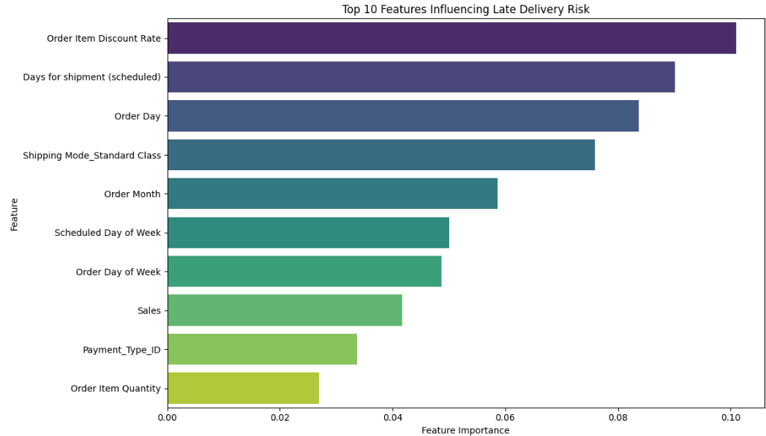
Late Delivery Prediction — Key Features
#1 Discount Rate
High discounts drive late risk — possible stockout or slow pick/pack correlation.
#2 Scheduled Days
Unrealistic SLAs (especially First Class) are a primary predictor.
#3 Standard Class
38% late rate — routing, last-mile, and order complexity factors.
Time Features
Order day, month, and scheduled weekday are significant — seasonal peaks exist.

Slide 25
Feature Importance — Operational Actions
Top model predictors translated into business recommendations
#1 — 10.1%
Promotional and Discount Strategy (Discount Rate)
High discounts trigger volume spikes that overwhelm fulfilment capacity. Recommendations: Cap daily order volumes for deeply discounted items; add 1–2 buffer days to scheduled delivery when discount codes are applied; pre-stage inventory before sale events.
#2 — 9.0%
Shipping Mode Optimisation (Scheduled Days + Standard Class)
Scheduled windows are too rigid and don’t account for real carrier variability. Recommendations: Audit Standard Class carrier SLAs and shift volume to regional carriers on high-delay lanes; revise First Class SLA to 2 days to match operational reality.

Slide 26
Strategic Recommendations
01
Revise First Class SLA to 2 days to align with operational reality and reset customer expectations.
02
Deep-dive audit of Payment_Type_ID 4 gateway. Partner with provider to fix silent failure mode.
03
Suspend or review shipping to 100%-late-rate countries. Engage regional logistics partners.
04
Pre-position inventory near top markets (US, France, Mexico) for high-risk and discounted SKUs.
05
Implement predictive late-delivery model to flag at-risk orders at point of placement.
06
Enhance product content for Cleats, Footwear, Apparel to cut cancellations and reverse logistics.

Slide 27
Thank You
Freddy Fok
Questions & Discussion
DataCo Supply Chain Analytics · Comprehensive analysis of late deliveries, payment issues, product optimisation & predictive modelling

